Slide 1



X
KIMIA FARMA PERFORMANCE SUMMARY 2020-2023
Kimia Farma - Big Data Analytics
Presented by
Muhammad Fariz Shadiqin

Slide 2





Muhammad Fariz Shadiqin
Big Data Analytics
I am a Silviculture graduate from the Faculty of Forestry at the Bogor Agricultural Institute and shifting career into a Data Analyst. I have experience as a Data Analyst - Research and Development at iNews TV (MNC Media Group). I have a strong interest in Data Analyst, Data Visualization, and Python. I am a quick learner with excellent communication and time management skills.
Tanjung Priok, Jakarta
muhammadfarizshadiqin@gmail.com
www.linkedin.com/in/mfarizs

Slide 3

Courses and Certification
Certificate of Completion Data Science | Link Certificate January, 2025 Transcript Nilai Data Science | Link Certificate January, 2025

Slide 4
Outline
About Company
Table Analysis
Project Portofolio
Big Query Syntax
Importing Dataset
Dashboard Result

Slide 5

About Company
Kimia Farma, Indonesia's first pharmaceutical industrial company, was founded by the Dutch East Indies Government in 1817. Originally named NV Chemicalien Handle Rathkamp & Co., the company was nationalized in 1958 following Indonesian independence. The Government of the Republic of Indonesia merged several pharmaceutical companies into PNF (Perusahaan Negara Farmasi) Bhinneka Kimia Farma. On August 16, 1971, the legal entity of PNF was changed to a Limited Liability Company, and the company name was changed to PT Kimia Farma (Persero).

Slide 6
Project Portfolio
The Project-Based Internship Program, in collaboration with Rakamin Academy and Kimia Farma Big Data Analytics, is a self-development and career acceleration program designed for those interested in exploring the Big Data Analytics position at Kimia Farma. This program provides access to foundational learning through article reviews and company coaching videos, introducing participants to the competencies and skills required of Big Data Analysts. In addition to the learning materials, there will be weekly assignment questions to assess learning outcomes, culminating in a final project that will serve as a portfolio for this program.
The final task in this program is to create a dashboard visualizing the sales data for one of Kimia Farma's products over the past four years, using the provided raw data.

Slide 7
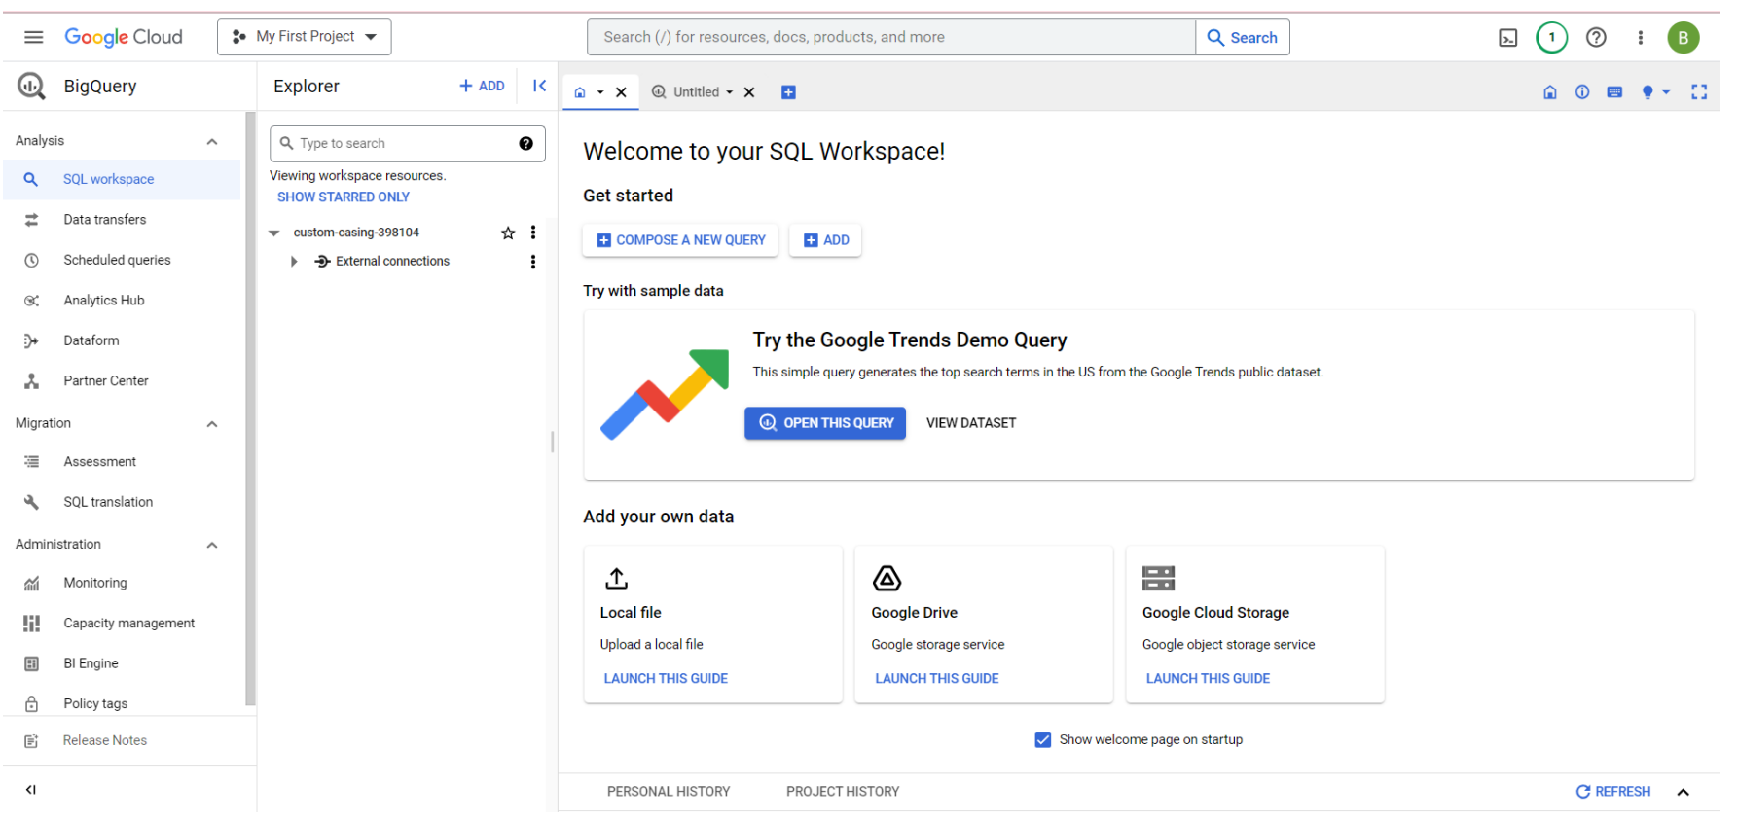

Importing Dataset to BigQuery

Slide 8
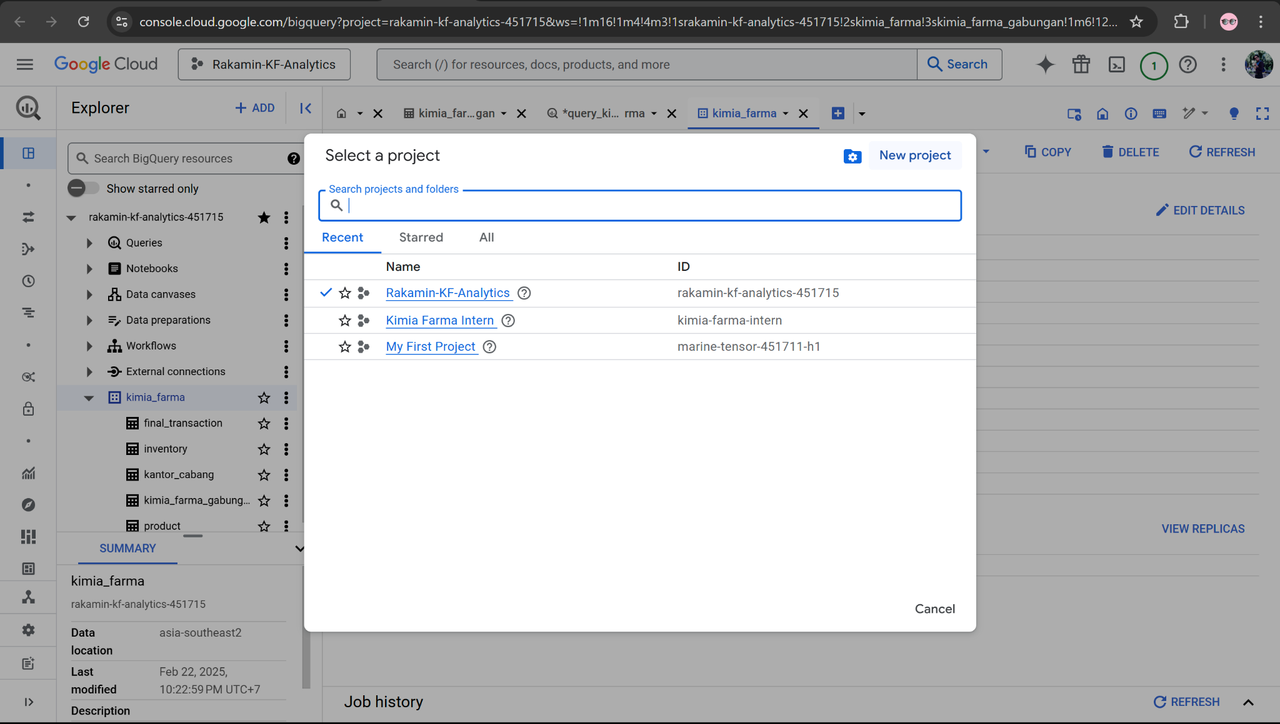
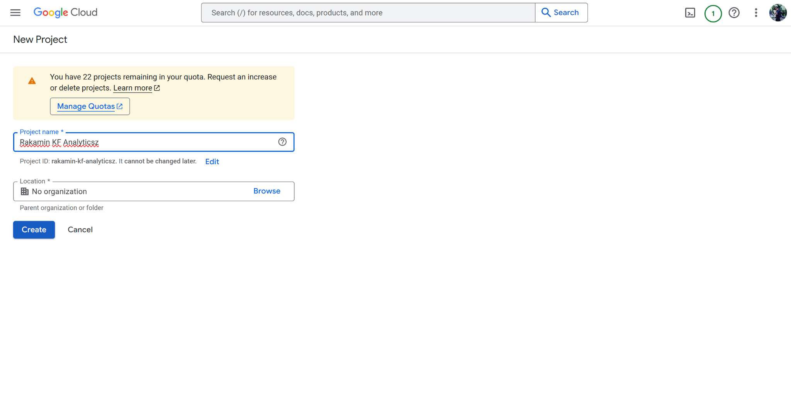
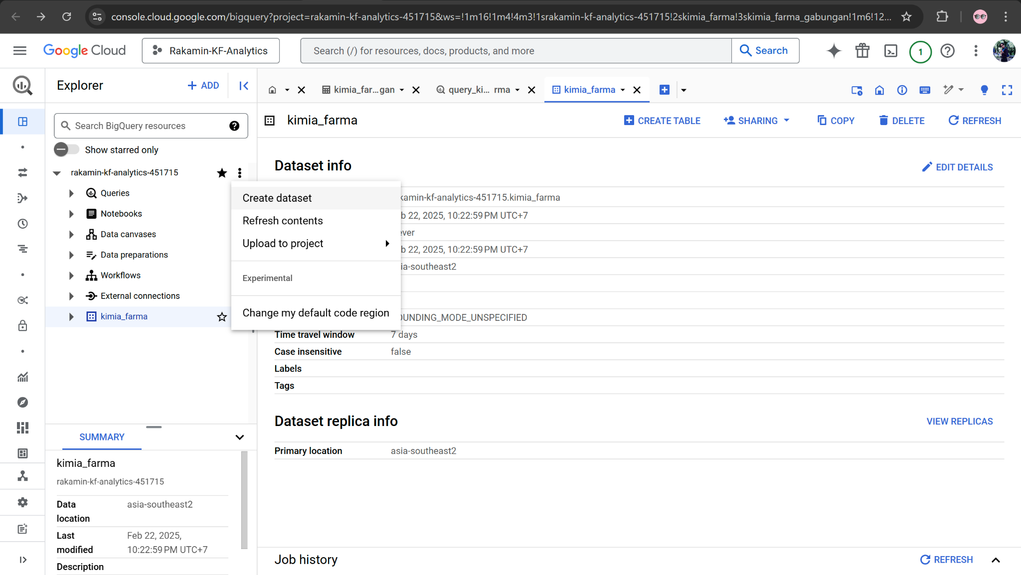
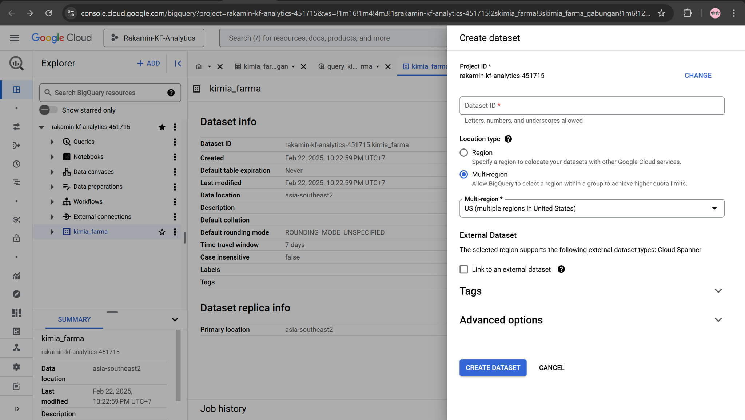
Importing Dataset to BigQuery

Slide 9
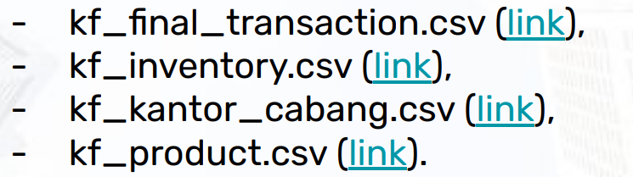
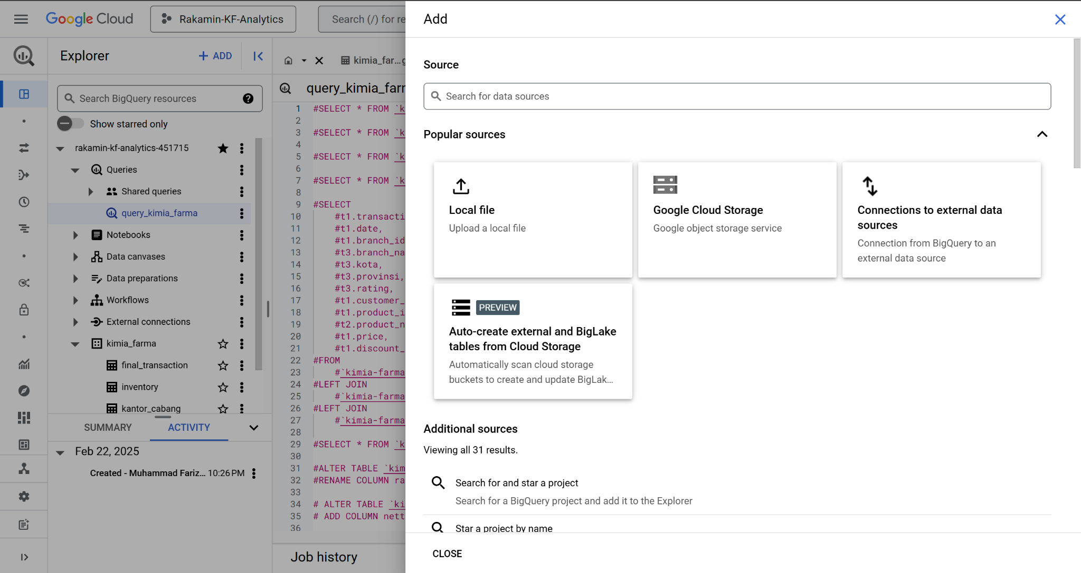
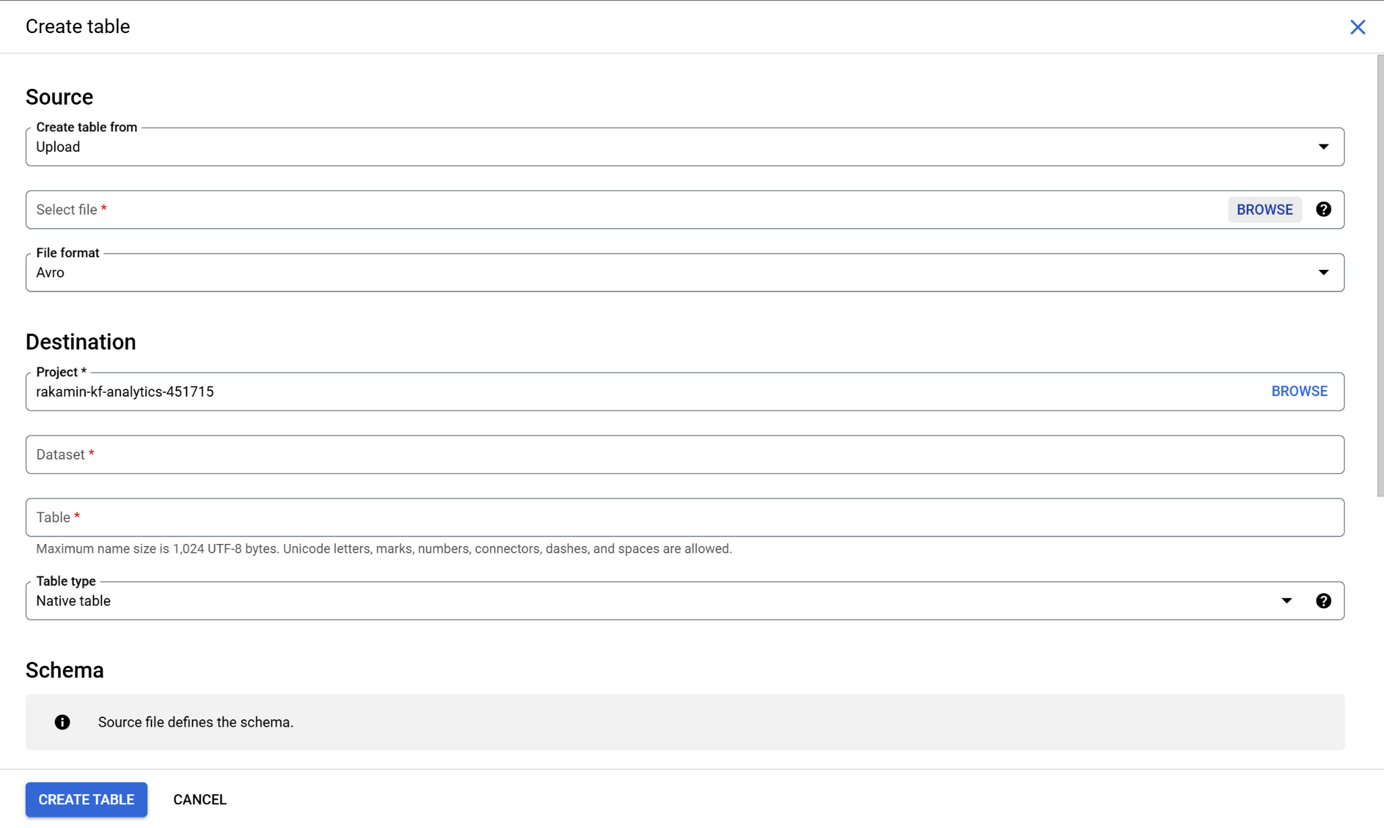
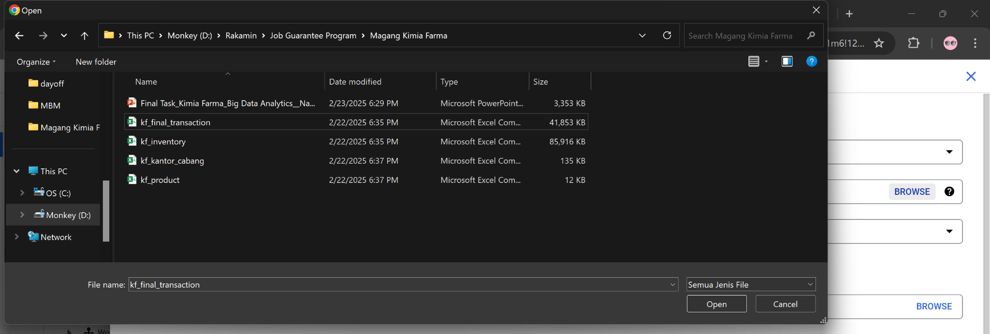
Importing Dataset to BigQuery

Slide 10
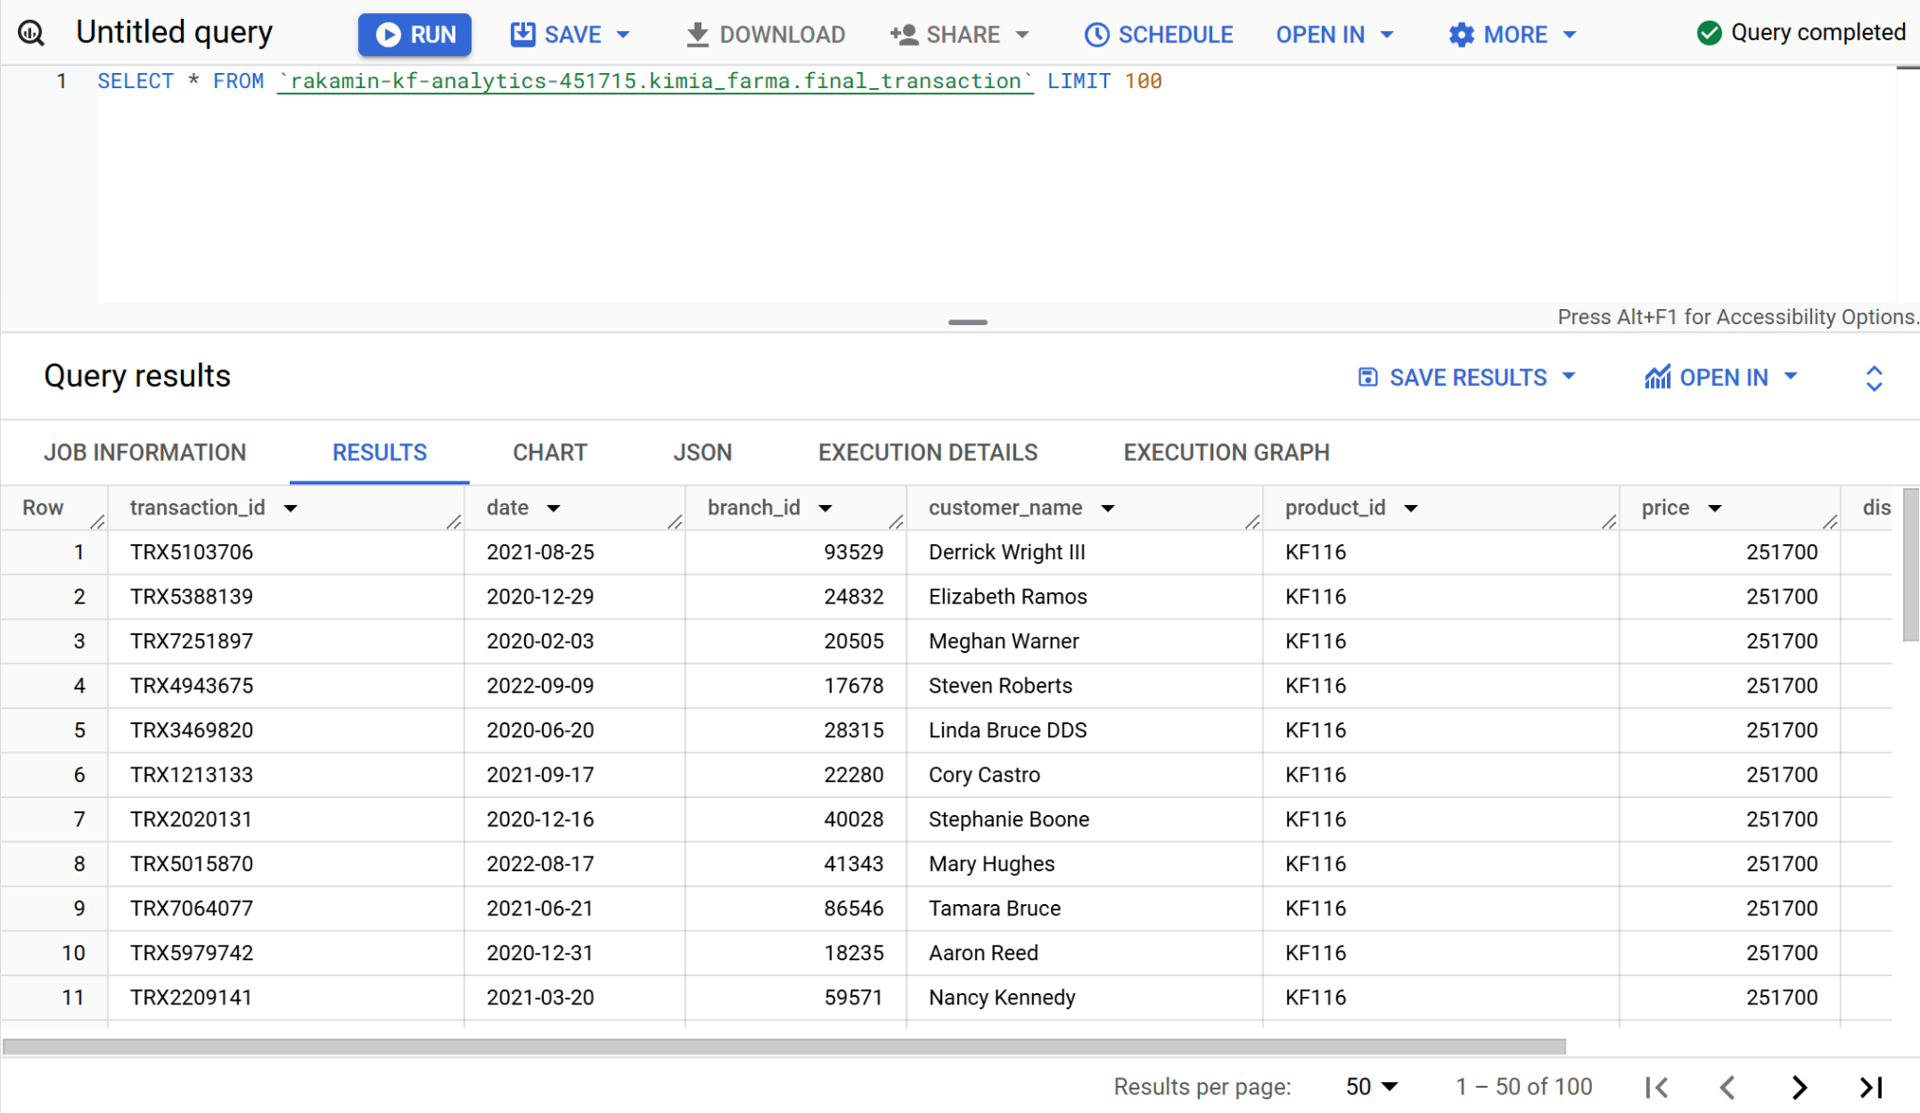
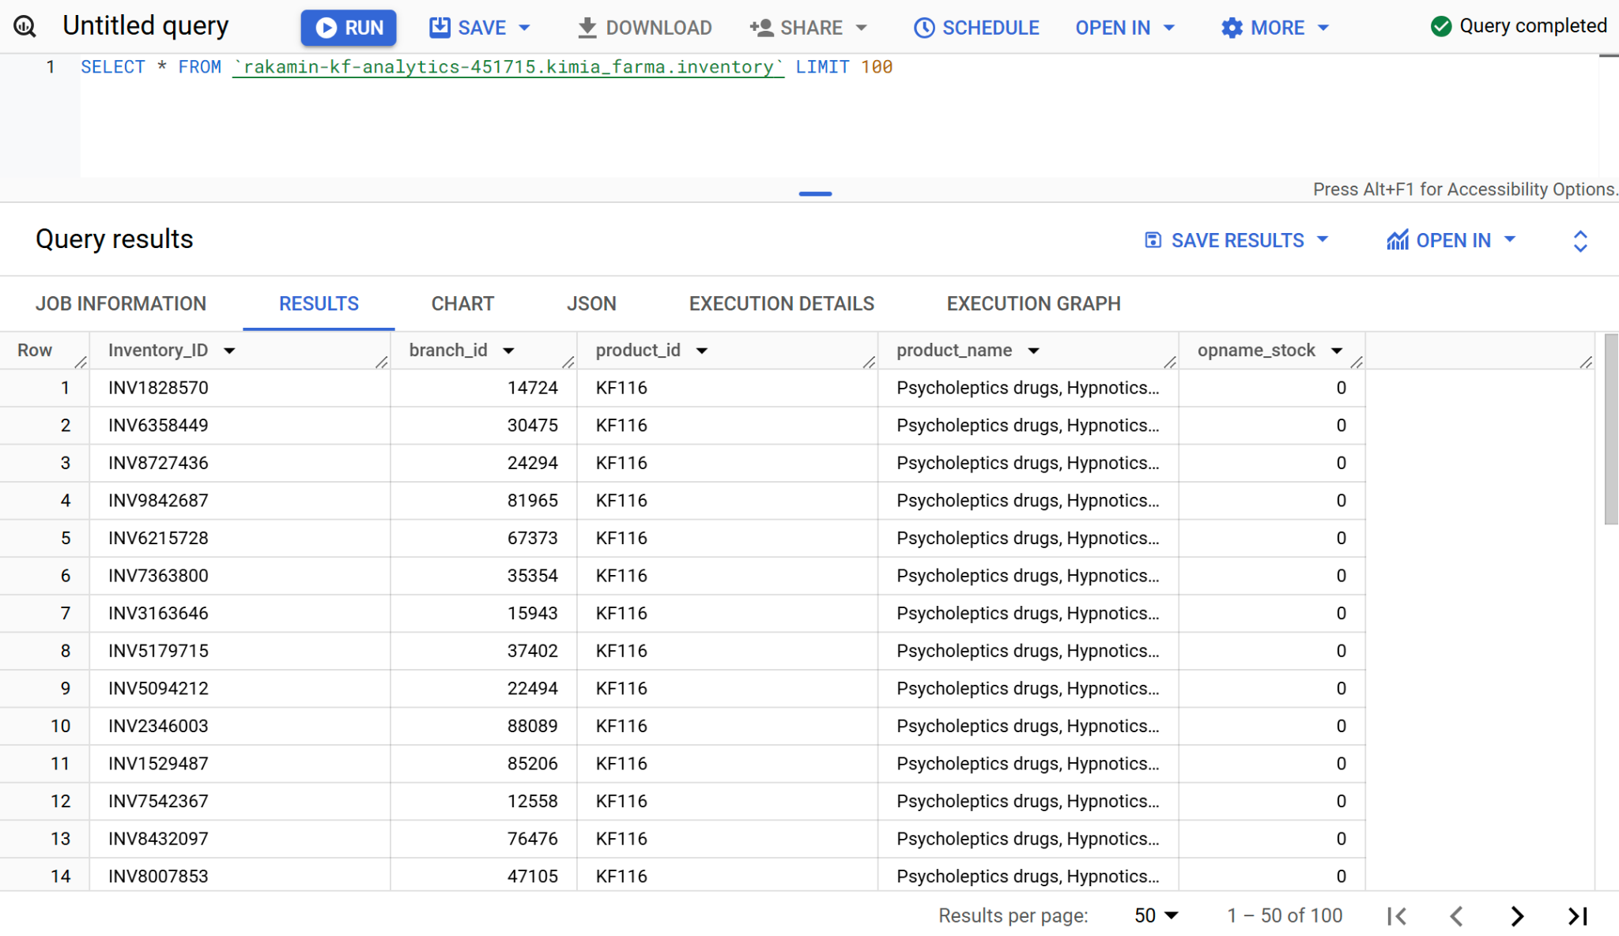
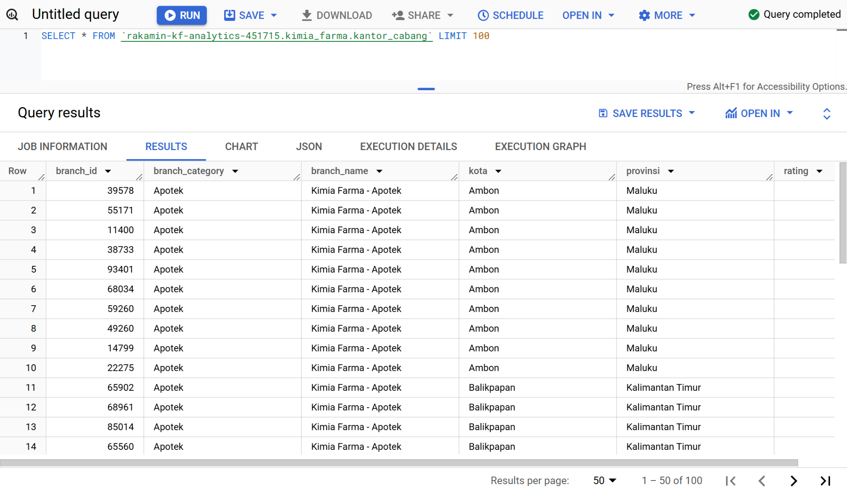
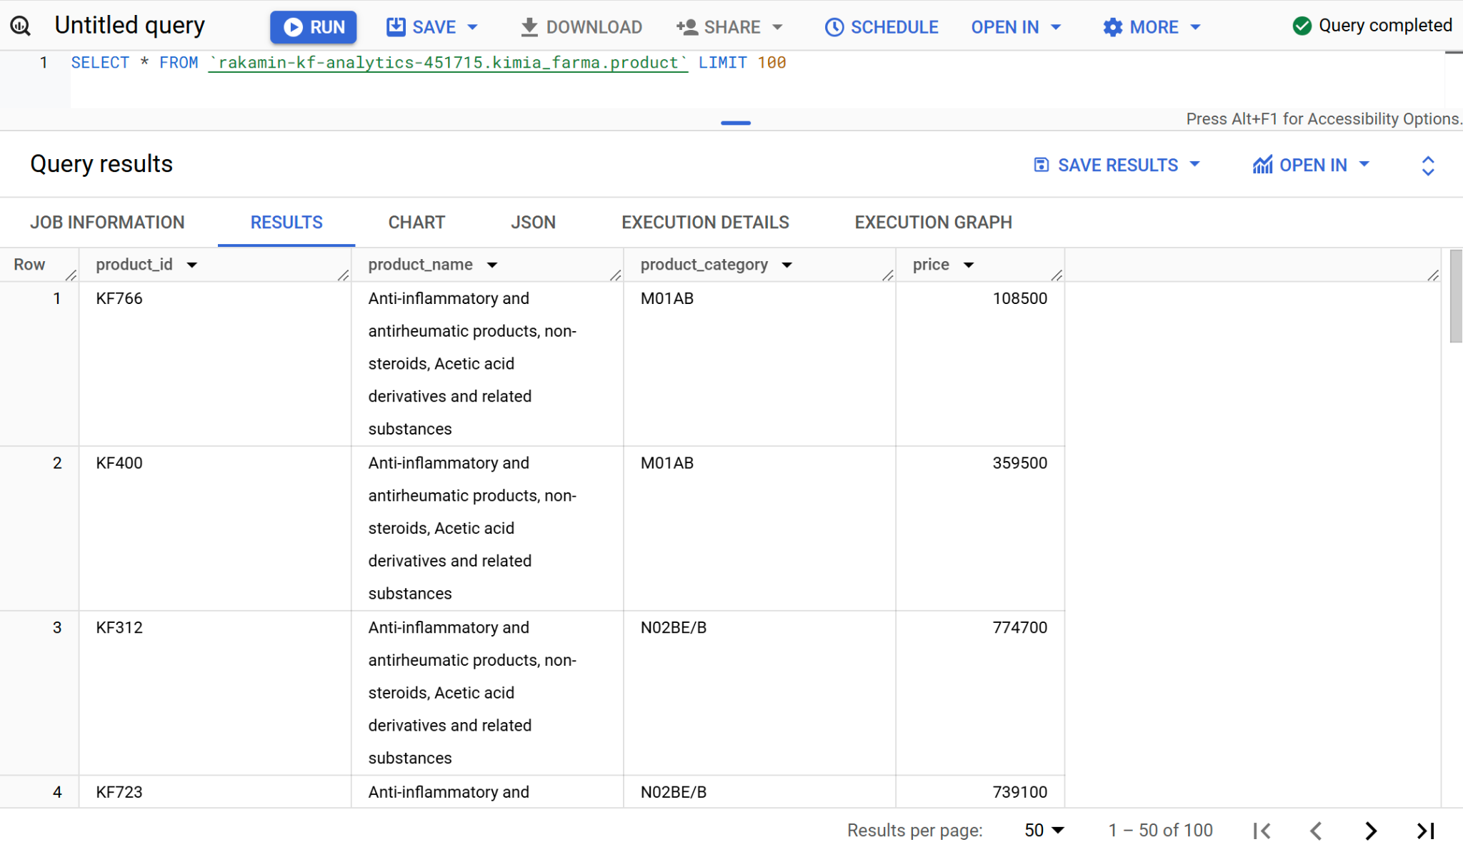
2. Tabel Analisa
Table final_transaction
Table inventory
Table kantor_cabang
Table product

Slide 11
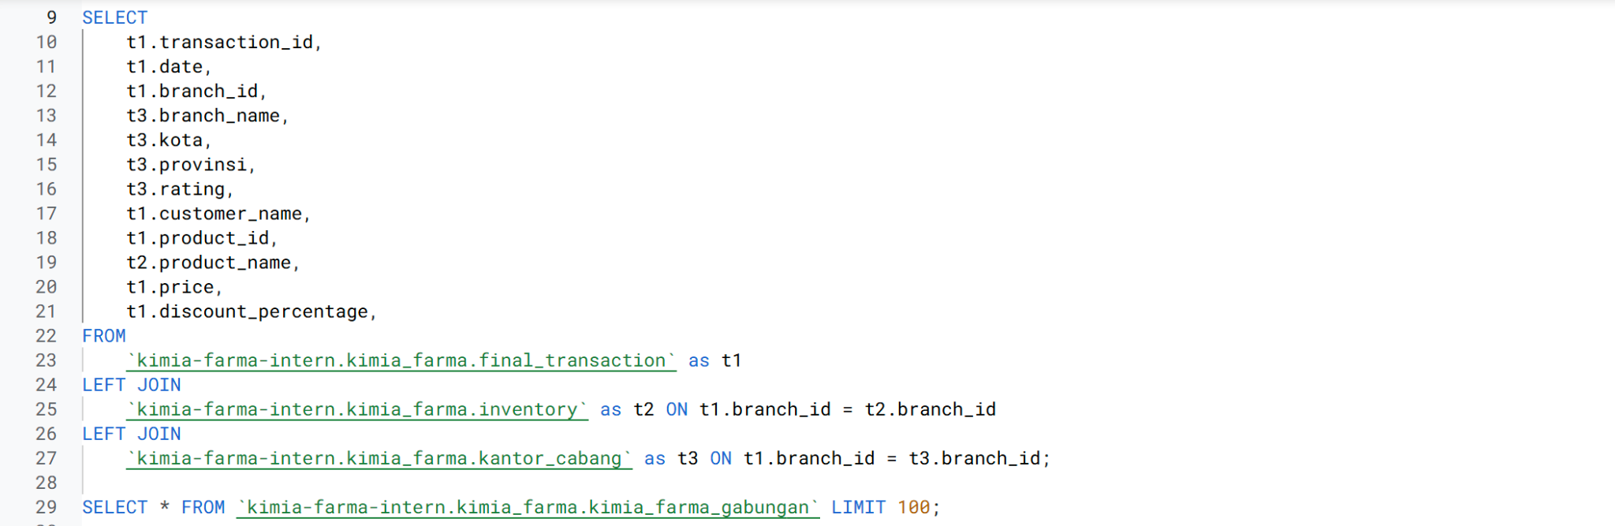
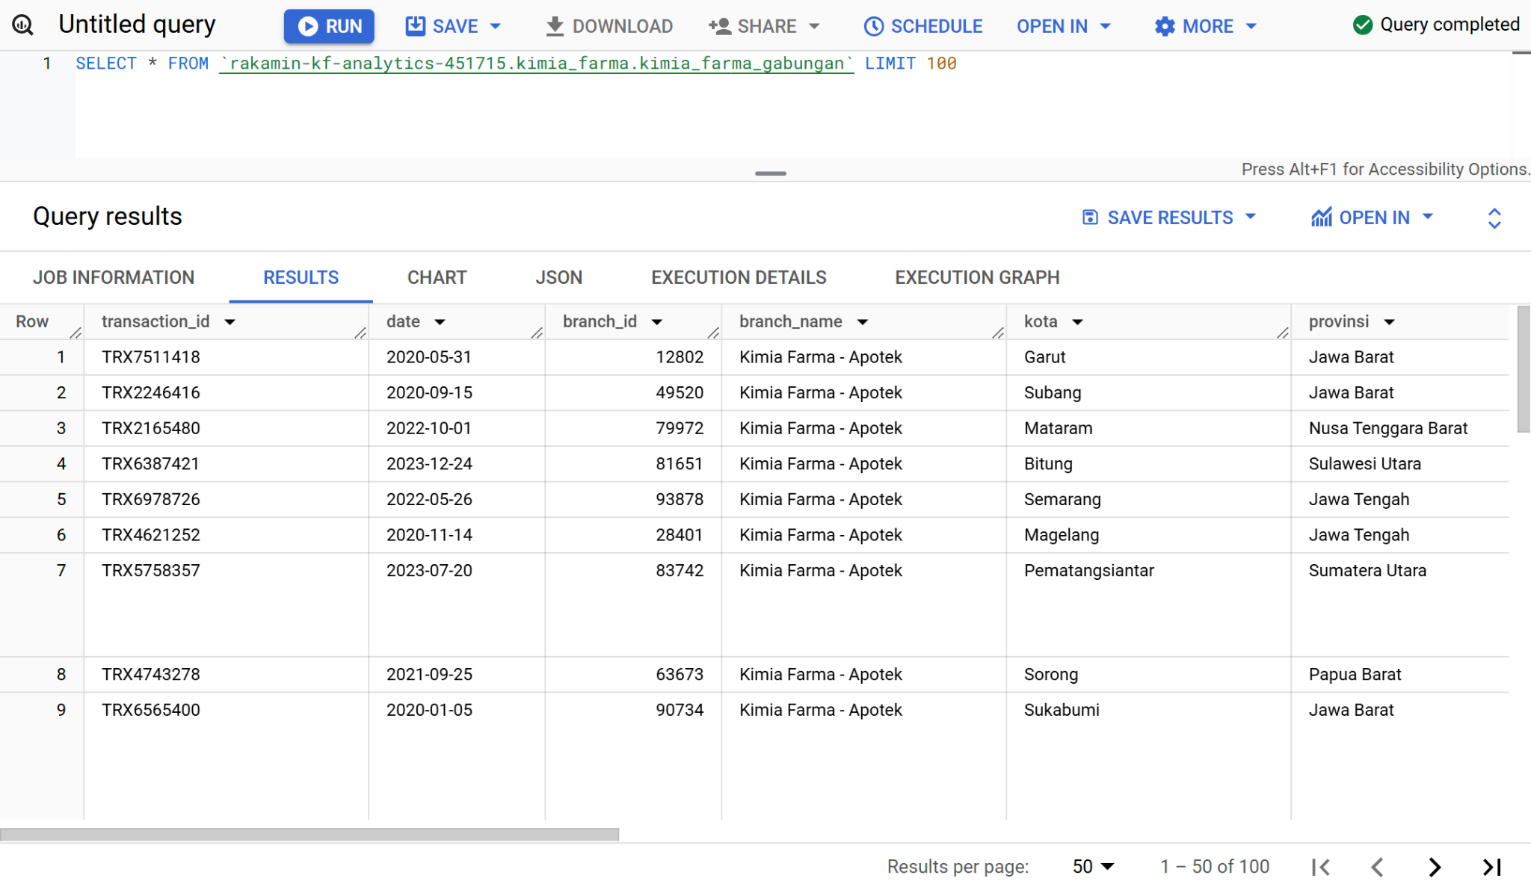
3. BigQuery Syntax

Slide 12
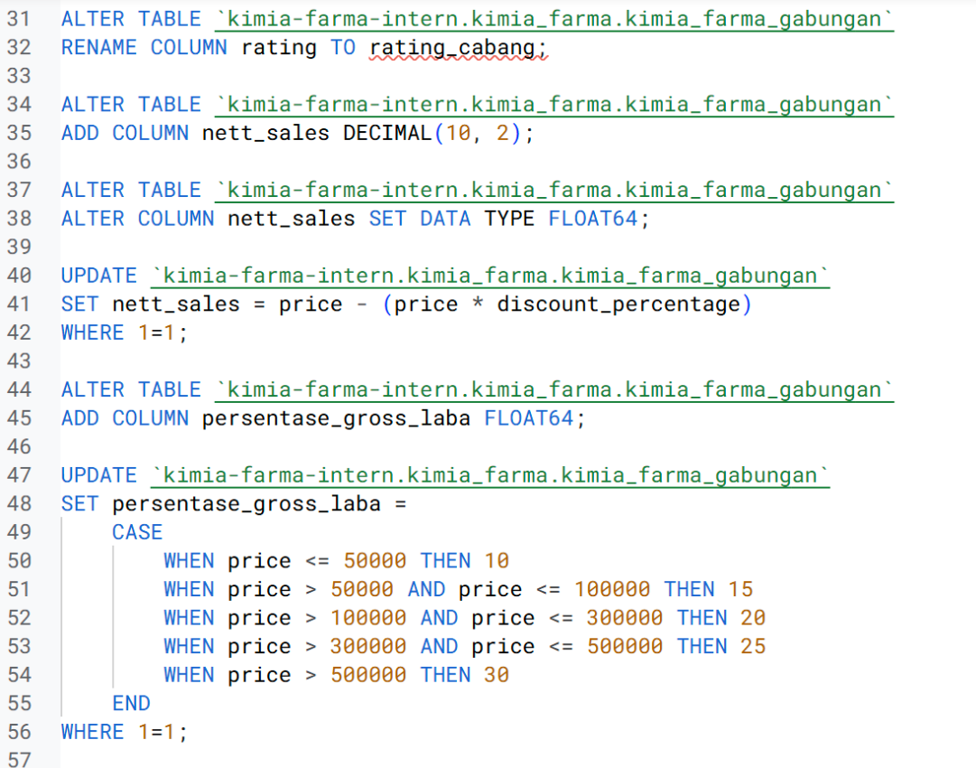
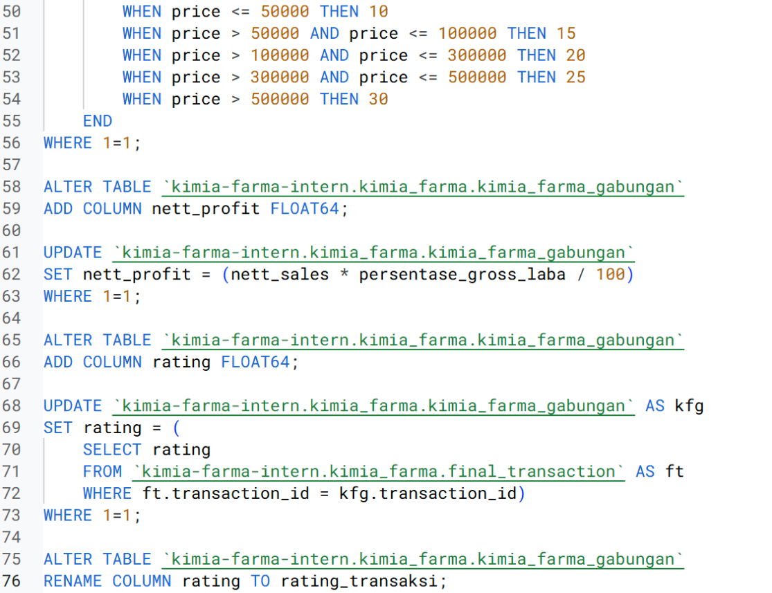
3. BigQuery Syntax
Rename the "rating" column to distinguish between customer ratings for transactions (found in the final_transaction table) and customer ratings for branches (found in the branch_office table).
I also added several new columns, such as persentase_gross_laba, nett_sales, dan nett_profit.

Slide 13
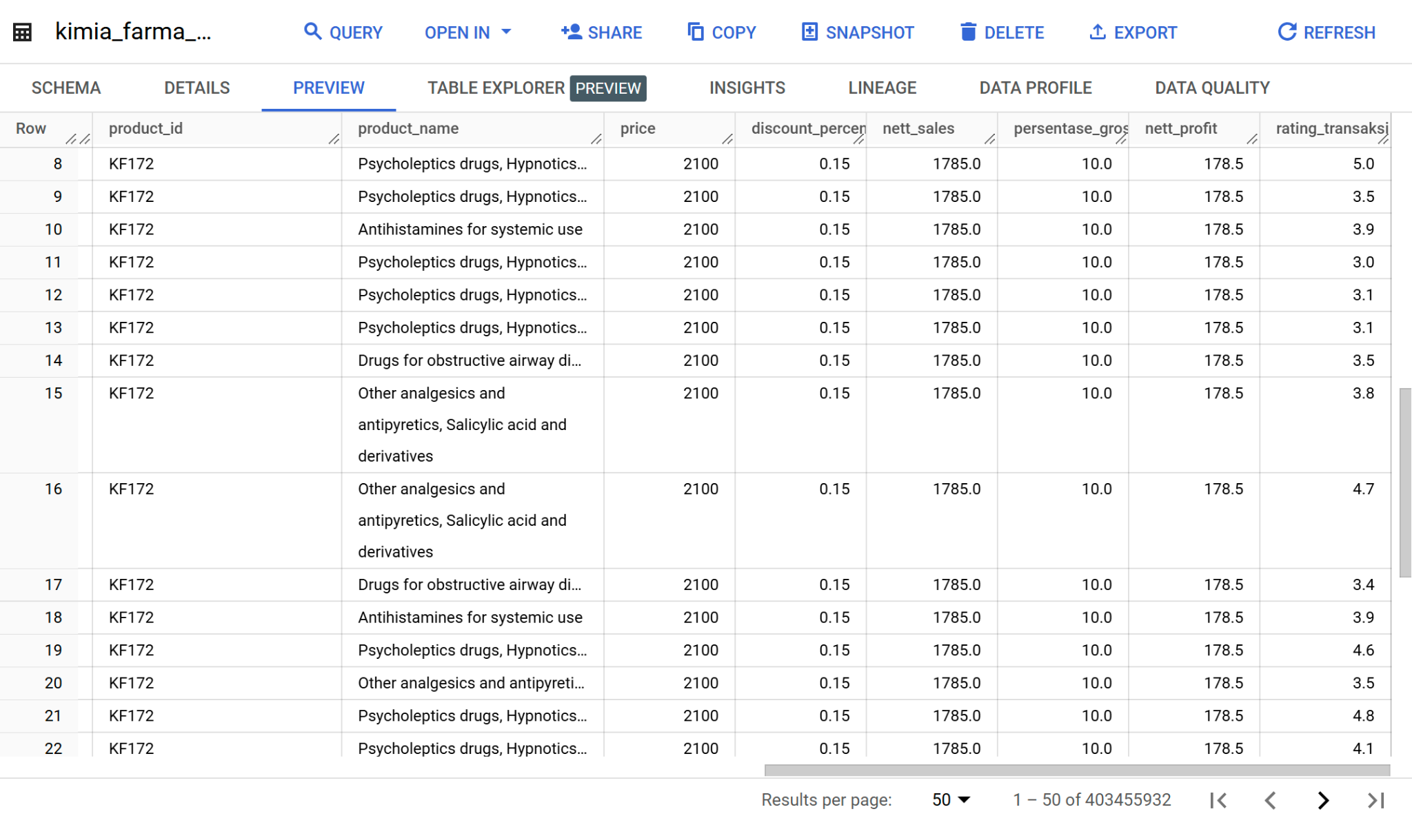
3. BigQuery Syntax

Slide 14
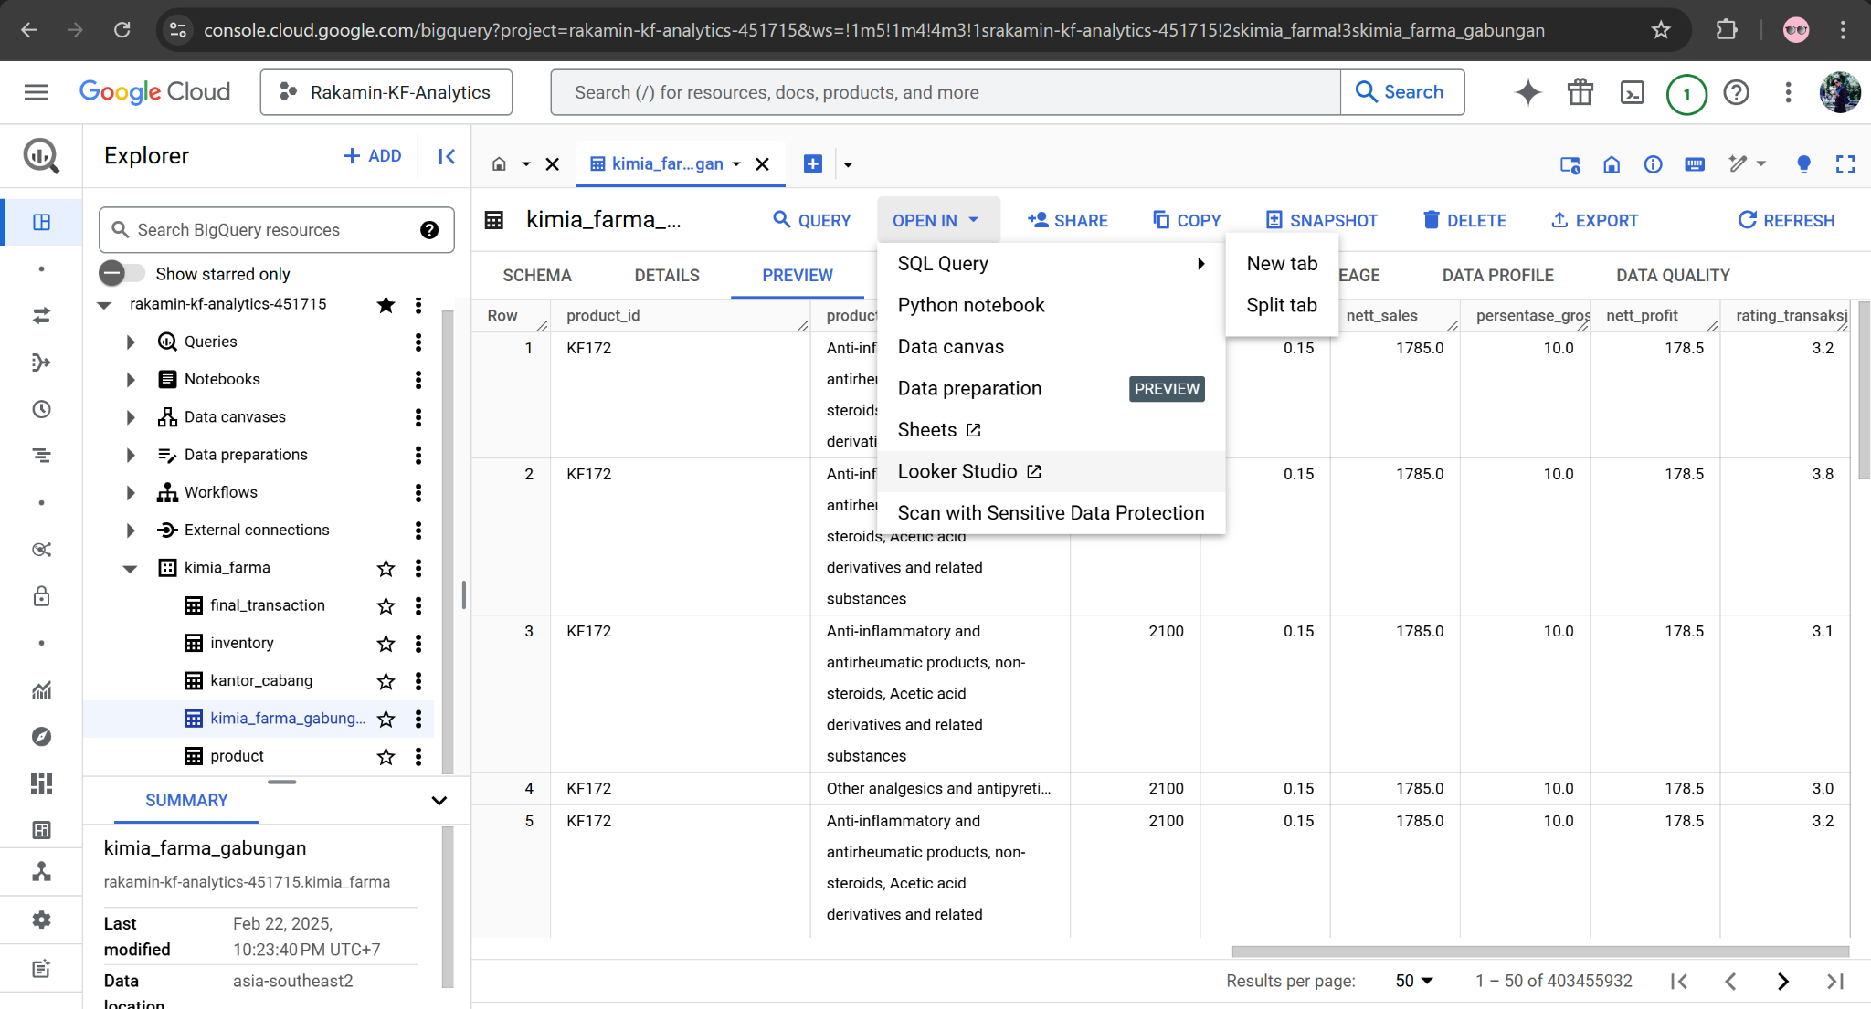
3. BigQuery Syntax

Slide 15
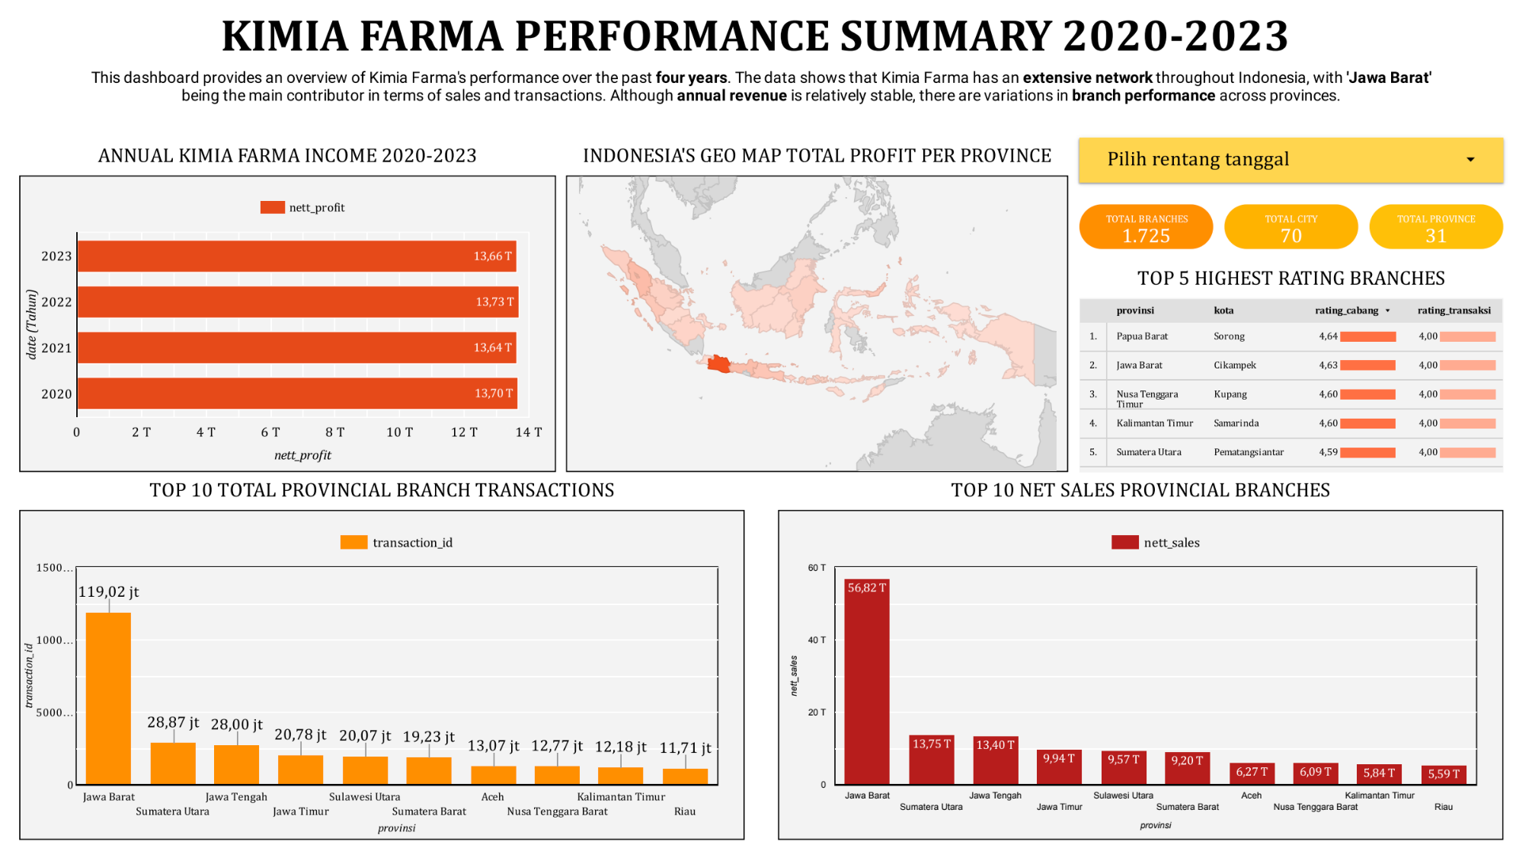
4. Dashboard Performance Analytics

Slide 16
Attachment
GitHub | Link GitHub
Lookerstudio | Link Dashboard
GDrive | Link GDrive
BigQuery | Link BigQuery
Presentation | Link Presentation

Slide 17
Thank You
X

